Slide 1

CMR TECHNICAL CAMPUS Accredited by NBA, Approved by AICTE, affiliated to JNTUH Kandlakoya (V), Medchal Road, Hyderabad -501401
DEPARTMENT OF COMPUTER SCIENCE AND ENGINEERING
Mental Health Prediction Using Machine Learning
Under the guidance
K. Praveen Kumar
GROUP MEMBERS:
A. Mahesh (197R5A0507)
B. Swathi (197R5A0508)
Nusrath Jahan (197R5A0506)

Slide 2
content
Abstract
Existing System
Disadvantages
Proposed System
Advantages
Hardware Requirements
Software Requirements
Project Architecture
Modules
Usecase Diagram
Class Diagram
Sequence Diagram
Activity Diagram
Sample Code
Conclusion

Slide 3
abstract
The emotional, psychological and social welfare of a person is revealed by their mental health. It influences how an individual will think, feel or handle a situation. Positive mental health helps an individual to work productively and achieve their full potential. At each point in life, mental health is vital, from childhood to adulthood. Numerous factors contribute to mental health issues which lead to mental illness like stress, social anxiety, depression, obsessive compulsive disorder, drug addiction, workplace issues and personality disorders. The onset of mental illness should be determined without flaws for maintaining an appropriate life balance. We have collected data from online available datasets. The data has been label encoded for better prediction. The data is being subject to various machine learning techniques to obtain labels. These classified labels will then be used to build a model to predict the mental health of an individual. Our target population is in the working class i.e people above the age of 18. Once the model is built, it will be integrated to a website so that it can predict the outcome as per the details provided by the user.

Slide 4
Existing system
The existing systems gives the immense understanding of the mental health analysis amongst different target groups using different technology.
The classification models performance can be improved using deep learning methods such as recurrent neural networks.

Slide 5
disadvantages
The prediction of mental Health treatment shows the results of the state of a person in which positive or negative condition.
A person is having a negative kind of condition is always being in bad state and he is supposed to in serious manner of is health and having lot of issues in his personal life.

Slide 6
Proposed system
To resolve the mental well-being machine learning technique play important role. It holds great promise to transform mental health care. Its tools also hold the potential to extend the current capabilities of clinicians, to deal with complex problems and ever-expanding information streams that stretch the limits of human ability.
We have developed a framework for determining the mental health state of an individual. For further improvements the concept of Machine Learning can be used for very large dataset.
Our proposed different levels of questionnaire and based on the results of that provide free checking of a person’s mental state and help him by diagnosis prediction.

Slide 7
advantages
To ensure availability and accessibility of minimum mental health care for all in the foreseeable future, particularly to the most vulnerable and underprivileged sections of the population.
To encourage the application of mental health knowledge in general health care and in social development
To promote community participation in the mental health services development and to stimulate efforts towards self help in the community
To know the major cause of mental illness through mental health analysis.

Slide 8
Hardware requirements
System : i5 processor.
Hard Disk : 100 GB.
Ram : 4GB

Slide 9
Software requirments
Operating system : Windows 7.
Coding Language : Python.
Tool : Jupyter NoteBook, Colab

Slide 10
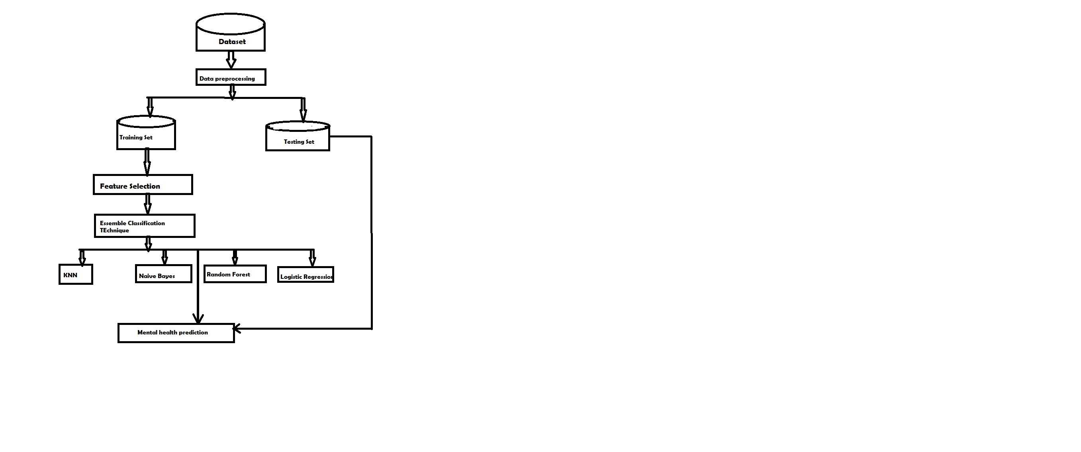
architecture

Slide 11
MODULES
DATA-PREPROCESSING:
Data preprocessing is a technique that is used to convert raw data into a clean dataset.
The data is gathered from different sources is in raw format which is not feasible for the analysis.
In order to perform data preprocessing using Python, we need to import some predefined Python libraries they are :
Numpy: Numpy Python library is used for including any type of mathematical operation in the code.
Pandas: The last library is the Pandas library, which is one of the most famous Python libraries and used for importing and managing the datasets.
Matplotlib – Matplotlib is a Python 2D plotting library that is used to plot any type of charts in Python.
Pre-processing for this approach takes 4 simple yet effective steps:

Slide 12
Attribute Selection: The attribute like serial no. is not required. The main attributes used for this study are GRE Scores, TOEFL Scores, CGPA, and University Ranking.
Cleaning missing values: The library used for the task is called Scikit Learn preprocessing. It contains a class called Imputer which will help us take care of the missing data.
Feature Scaling : It is performed during the data pre-processing to handle highly varying magnitudes or values or units.
If feature scaling is not done, then a machine learning algorithm tends to weigh greater values, higher and consider smaller values as the lower values, regardless of the unit of the values.
A feature scaling in machine learning model is based on Euclidean distance.
Training and Test data Splitting the Dataset into Training set and Test Set: The next step is to split our dataset into two. Training set and a Test set.
We will train our machine learning models on our training set and then we will test the models on our test set to examine how accurately it will predict.
A general rule of the thumb is to assign 75% of the dataset to training set and therefore the remaining 25% to test set.

Slide 13
Machine learning models
They are several ML models have to be developed using various machine learning algorithms for admission prediction to a particular university. Algorithms are :
MULTIPLE LINEAR REGRESSION WITH PCA:
Multiple regression analysis is one of the most widely used methodologies for expressing the dependence of a response variable on several predictor variables.
Due to the presence of multicollinearity, the standard errors of the parameter estimates could be quite high.
The specific goals of principal component analysis are to reduce a large number of predictor variables to smaller no. of principal components and to provide a regression equation for an underlying process by using predictor variables.
Principal components can be derived such that they are nearly uncorrelated or orthogonal. Thus the problem of multicollinearity among the variables can be solved by using PCA.

Slide 14
Data gathering
Data gathering is the process of collecting and measuring information from countless different sources.
In order to use the data we collect to develop practical machine learning solutions, it must be collected.
The dataset has been collected from students of different colleges. The dataset collected consist of instances of students.
To use the dataset in our code, we usually put it into a CSV file.

Slide 15
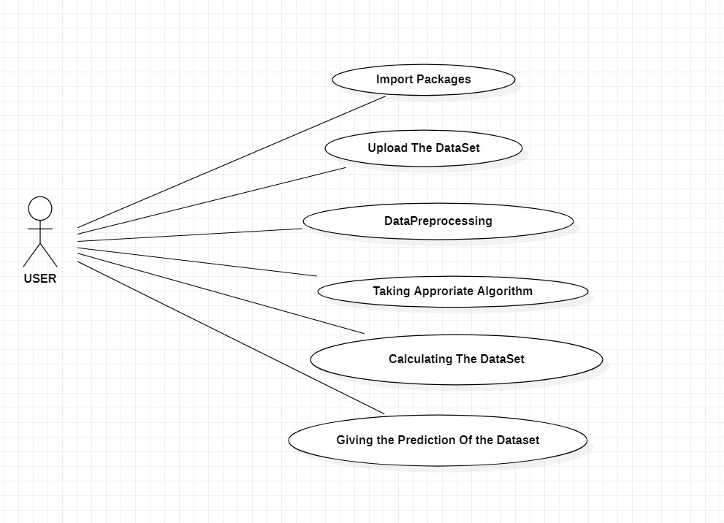
USECASE DIAGRAM

Slide 16
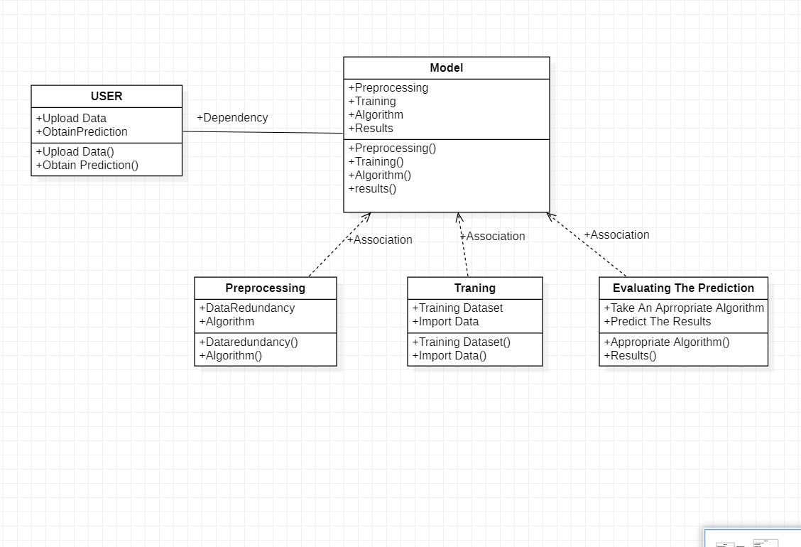
CLASS DIAGRAM

Slide 17
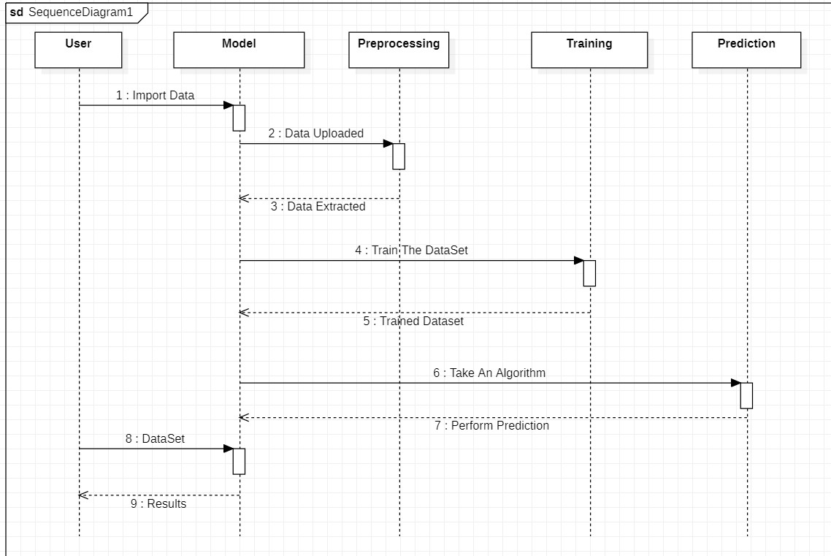
SEQUENCE DIAGRAM

Slide 18
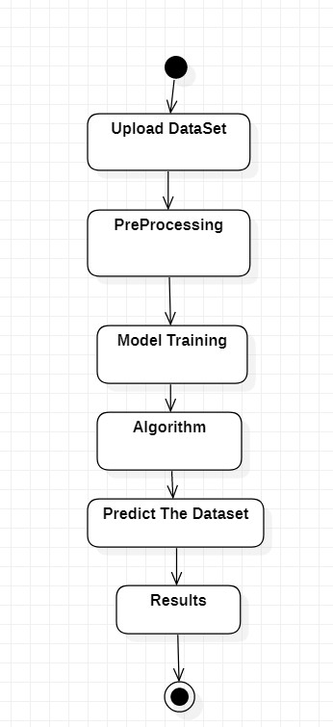
ACTIVITY DIAGRAM

Slide 19
SAMPLE CODE
import numpy as np # linear algebra
import pandas as pd # data processing, CSV file I/O (e.g. pd.read_csv)
import matplotlib.pyplot as plt
import seaborn as sns
from collections import Counter from scipy import stats
from scipy.stats import randint
from sklearn.model_selection import train_test_split
from sklearn import preprocessing
from sklearn.datasets import make_classification
from sklearn.preprocessing import binarize, LabelEncoder, MinMaxScaler
//algorithms
from sklearn.linear_model import LogisticRegression
from sklearn.tree import DecisionTreeClassifier
from sklearn.ensemble import RandomForestClassifier, ExtraTreesClassifier
from sklearn import metrics
from sklearn.metrics import accuracy_score, mean_squared_error, precision_recall_curve
from sklearn.model_selection import cross_val_score
from sklearn.neural_network import MLPClassifier
from sklearn.model_selection import RandomizedSearchCV

Slide 20
SAMPLE CODE
from sklearn.ensemble import BaggingClassifier, AdaBoostClassifier
from sklearn.neighbors import KNeighborsClassifier
from sklearn.naive_bayes import GaussianNB
import csv data = open("/content/drive/MyDrive/survey.csv")
data = csv.reader(data)
print(data) train_df = pd.read_csv('/content/drive/MyDrive/survey.csv')
print(train_df.shape)
total = train_df.isnull().sum().sort_values(ascending=False)
percent = (train_df.isnull().sum()/train_df.isnull().count()).sort_values(ascending=False)
missing_data = pd.concat([total, percent], axis=1, keys=['Total', 'Percent'])
missing_data.head(20)
print(missing_data)
train_df = train_df.drop(['comments'], axis= 1)
train_df = train_df.drop(['state'], axis= 1)
train_df = train_df.drop(['Timestamp'], axis= 1) train_df.isnull().sum().max() #just checking that there's no missing data missing...
train_df.head(5)
def logisticRegression():
# train a logistic regression model on the training set
logreg = LogisticRegression()
logreg.fit(X_train, y_train)
# make class predictions for the testing set
y_pred_class = logreg.predict(X_test)
print('########### Logistic Regression ######## Regres.'] = accuracy_score * 100

Slide 21
SAMPLE CODE
def Knn():
# Calculating the best parameters
knn = KNeighborsClassifier(n_neighbors=5)
# From https://github.com/justmarkham/scikit-learn-videos/blob/master/08_grid_search.ipynb
#tuningCV(knn)
#tuningGridSerach(knn)
#tuningMultParam(knn)
# define the parameter values that should be searched
k_range = list(range(1, 31))
weight_options = ['uniform', 'distance']
# specify "parameter distributions" rather than a "parameter grid"
param_dist = dict(n_neighbors=k_range, weights=weight_options)
tuningRandomizedSearchCV(knn, param_dist)
# train a KNeighborsClassifier model on the training set
knn = KNeighborsClassifier(n_neighbors=27, weights='uniform')
knn.fit(X_train, y_train)
# make class predictions for the testing set
y_pred_class = knn.predict(X_test)
print('########### KNeighborsClassifier ###############')

Slide 22
THANK YOU

